Slide 1
New Observations of the Neupert effect with the Solar dynamics observatory
Sam Schonfeld
Mentor: Phil Chamberlin

Slide 2
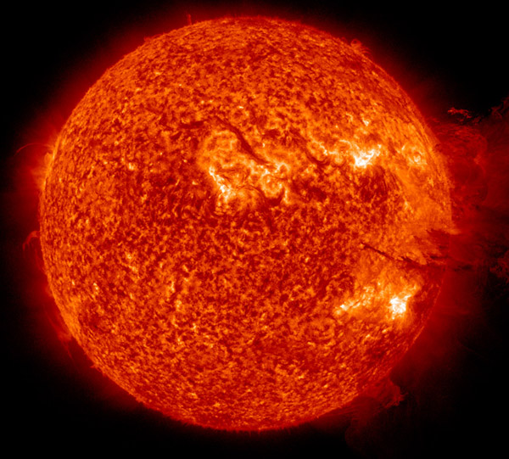
Outline
Background
Solar flare model
Instruments
The Neupert Effect
Research, initial findings
9 Mar 2011 X1.5
24 Feb 2011 M3.5
Conclusions / future work
7-Jun-2011 304Å

Slide 3
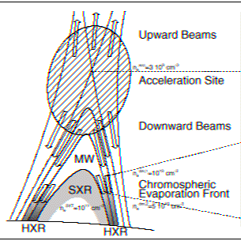
The Basic Solar Flare Model
Flares occur in active regions
Energy released by magnetic reconnection accelerates non-thermal electrons and ions
Electron and ion beams travel down magnetic loops into the Transition Region and Chromosphere where they release Bremsstrahlung radiation
Energy deposited by electron and ion beams raises the temperature (and pressure) of denser chromosphere plasma
Increased pressure leads to chromospheric evaporation, filling the magnetic loops with denser plasma

Slide 4
Instruments
Reuven Ramaty High Energy Solar Spectroscopic Imager (RHESSI)
HXR irradiance spectroscopy and imaging
Geostationary Operational Environmental Satellites (GOES)
SXR irradiance, used for flare classification
Solar Dynamics Observatory (SDO)
Atmospheric Imaging Assembly (AIA)
Imager in 7 EUV band passes
Extreme Ultraviolet Variability Experiment (EVE)
EUV irradiance spectroscopy

Slide 5
The Neupert Effect
Werner M. Neupert observed a correlation between the timing of peak microwave and soft x-ray emissions and that the integrated (in time) microwave emission approximately matched the soft x-ray profile (Neupert 1968)
Datlowe, Elcan and Hudson (1974) observed that in most flares a hard x-ray burst occurs shortly before the soft x-ray peak
These initial discoveries and further work have led to the statement of the Neupert Effect:
During the impulsive phase of a flare: SXR(t) $ \int_{t_{0}}^{t}{HXR}$ or equivalently: $\frac{dSXR}{dt}∝ HXR$
High percentage of flares expected to show this correlation
~80% (Dennis, Zarro)

Slide 7
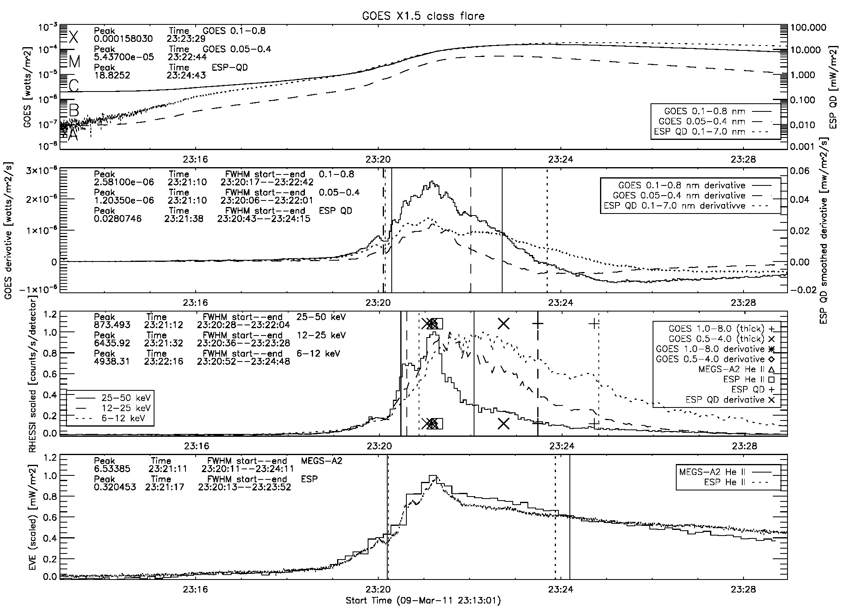

Slide 8
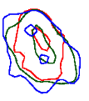
Contours are from 23:21:10 UT

Slide 10
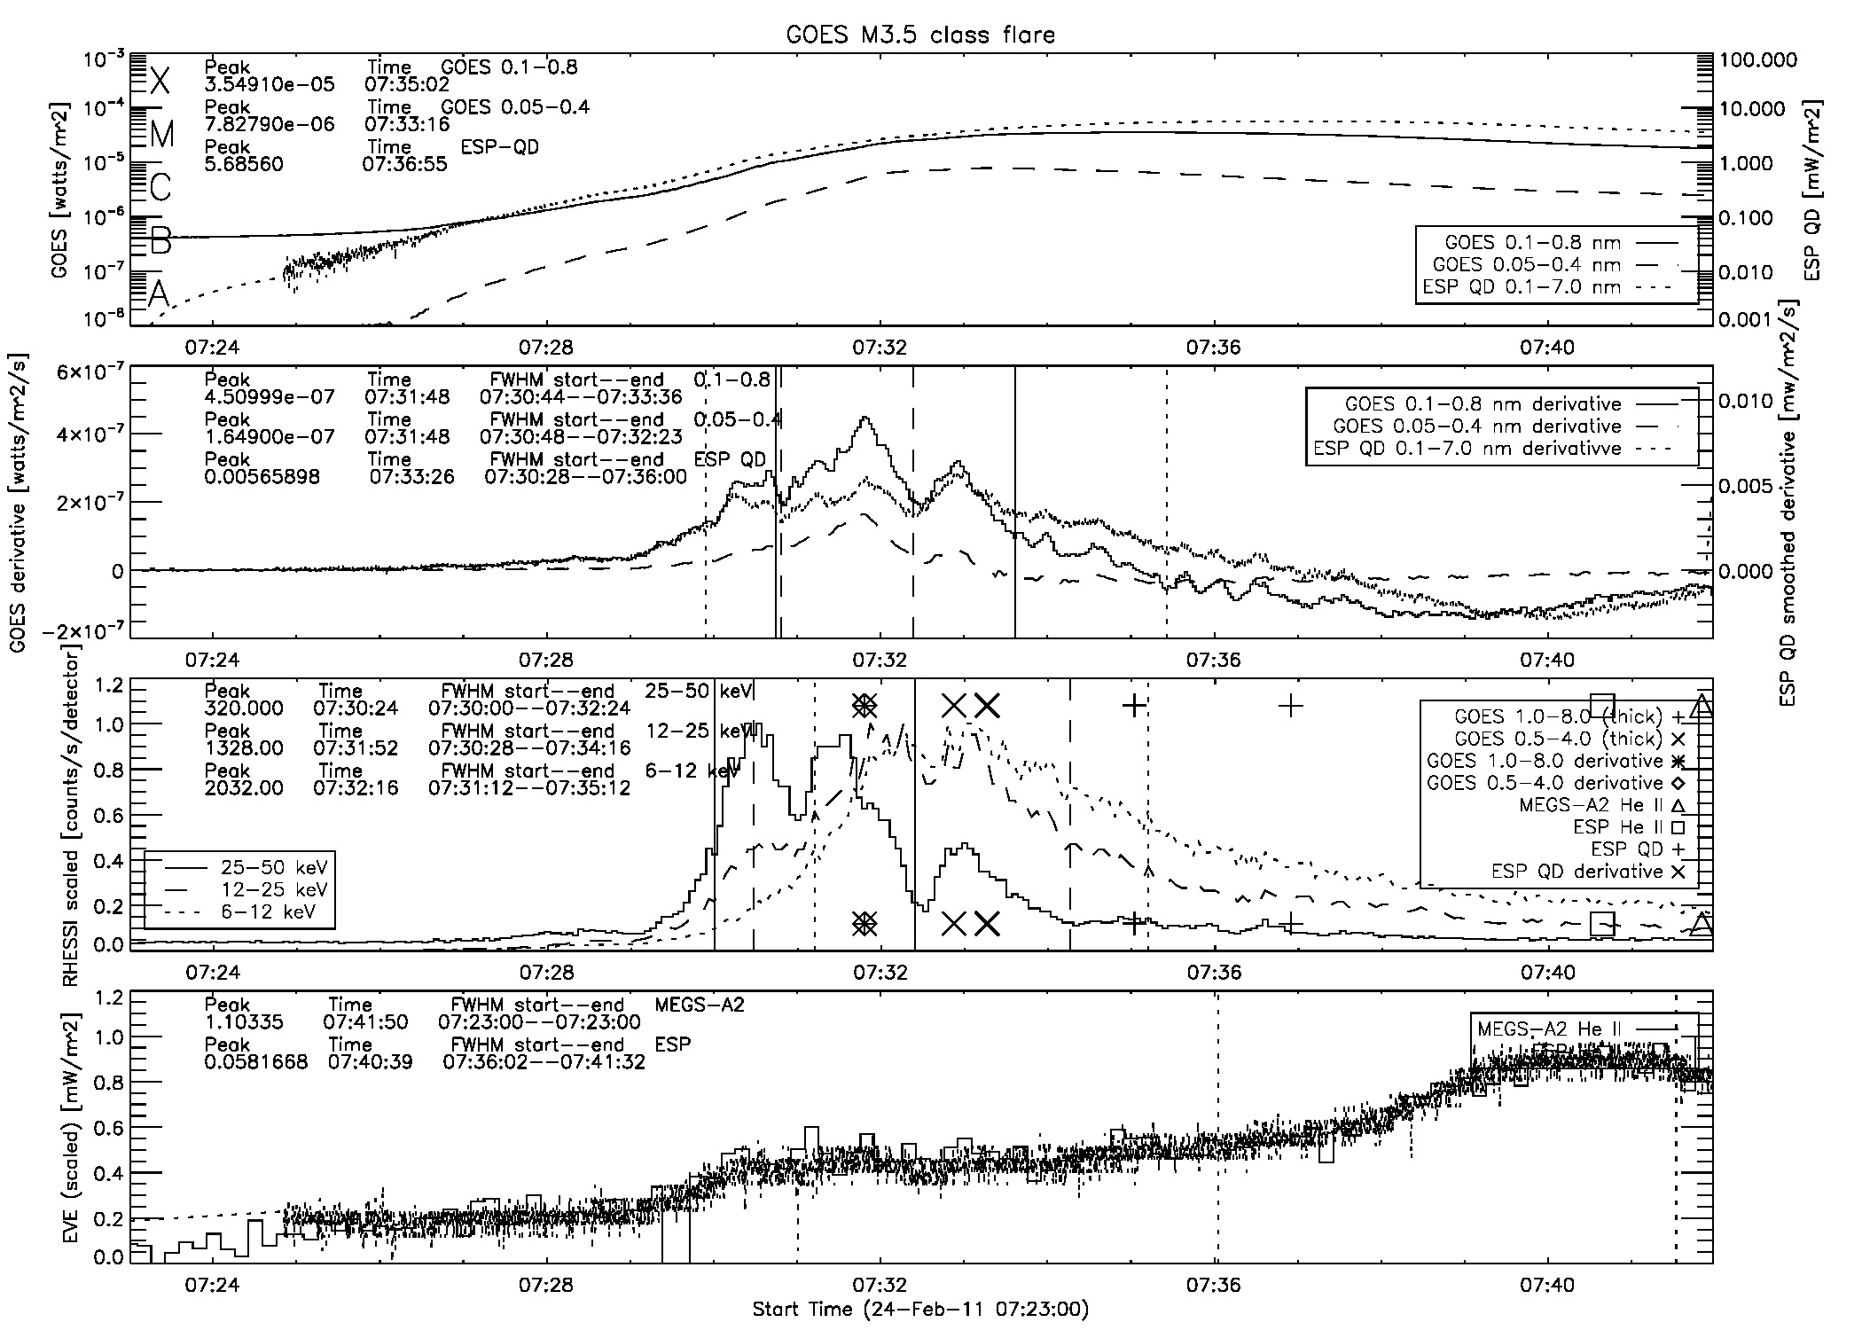

Slide 11
Contours are from 07:31:45 UT

Slide 12
Contours are from 07:31:45 UT

Slide 13
Conclusion
EUV spectral components of flares are observable with EVE and AIA
Chromospheric foot point heating can be observed in He-II 304Å emission line
Only ~40% of flares show clear Neupert Effect with strong temporal correlation between SXR derivative, 25-50 keV RHESSI HXR and He-II 304Å
Likely due to complexity and circumstances of flare, not a problem with the flare model
Things I didn’t have time to mention
Initial statistical analysis revealed He-II peak shows poorly constrained dependence on flare class
Neupert Effect events tend to show interesting temperature evolution
Simultaneous cooling and heating trends
Further Work
Examine more EUV lines
Use OSPEX to analyze HXR spectra
Continue statistical analysis

Slide 14
References
Neupert, W. M.: 1968, Astrophys. J. 153, L59.
Datlowe, D. W., Elcan, M. J., and Hudson, H.S.: 1974, Solar Phys. 39,155.
Dennis, B. R., and Zarro, D. M.: 1993, Solar Phys. 146, 177-190.
Allred, J. C., Hawley, S. L., Abbett, W. P., and Carlsson, M.: 2005, 630, 573.
All images not made by me were found through Google

Slide 15
Signature Flare Emissions
Non-thermal hard x-ray (HXR) continuum produced in loop footprints by Bremsstrahlung radiation
Thermal HXR continuum can also be produced in loops
SXR released by thermal plasma filling the flaring loops
Flares classified by peak soft x-ray (SXR) continuum emission
Extreme Ultraviolet (EUV) line emission from plasma with T=10,000K—10⁷K (and higher) found in Chromosphere, Transition region and Corona
Visible light emitted in white light flares
Microwave and Radio
7-Mar-2011 171Å

Slide 16
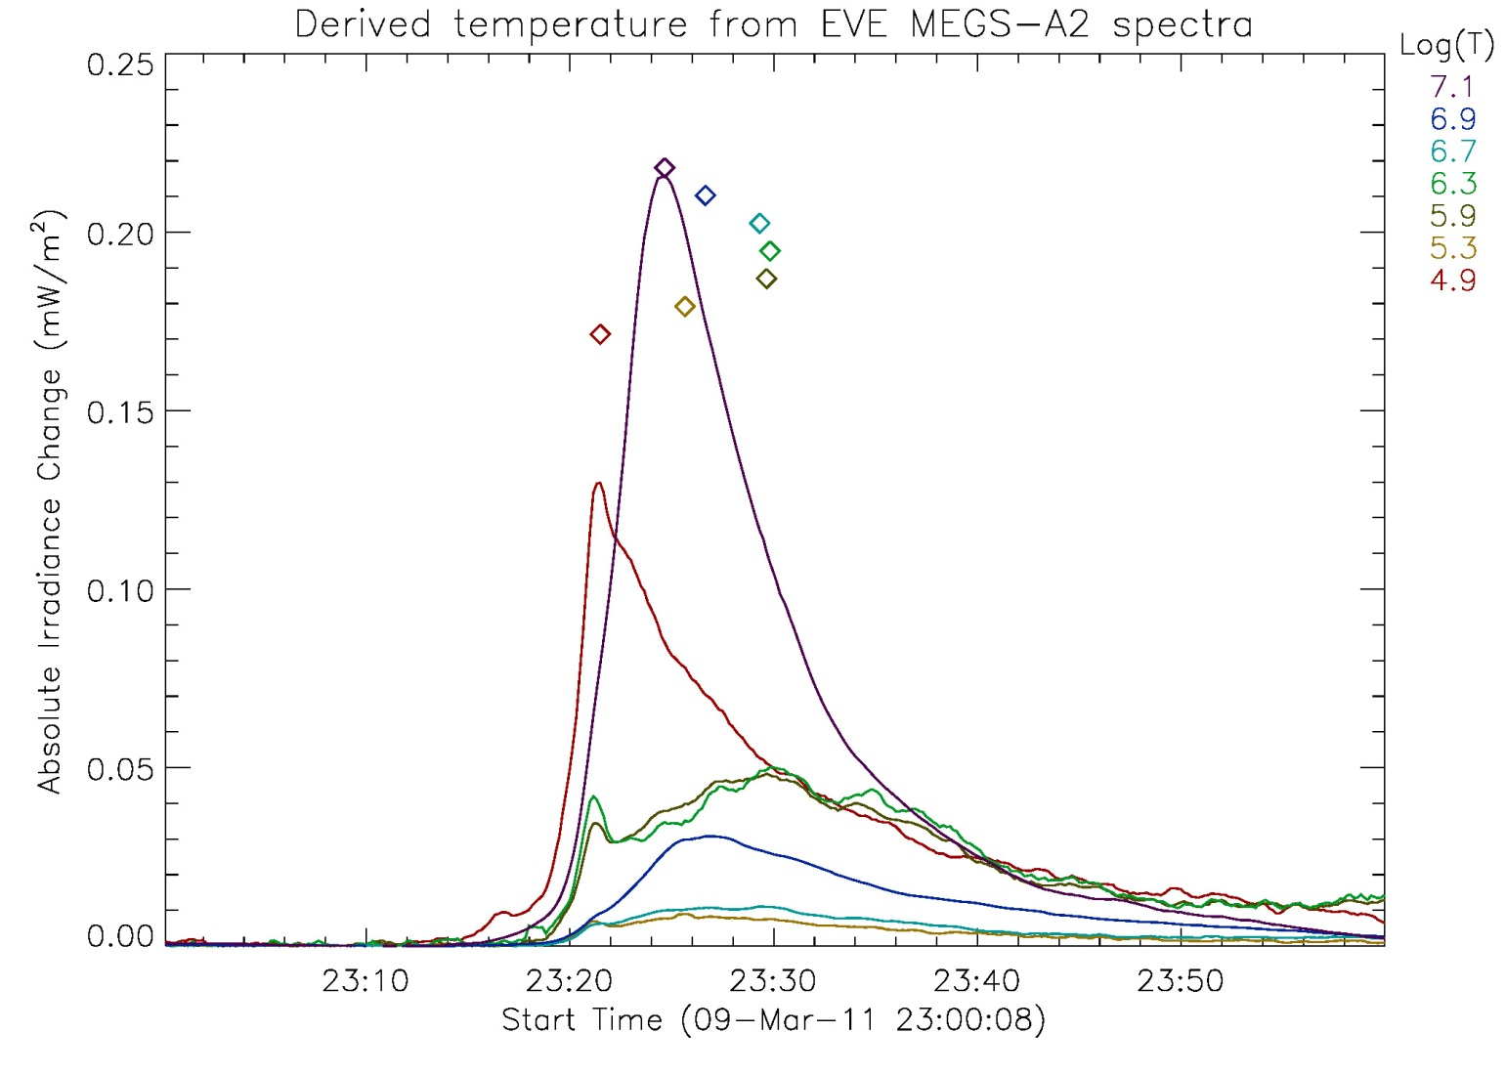

Slide 17
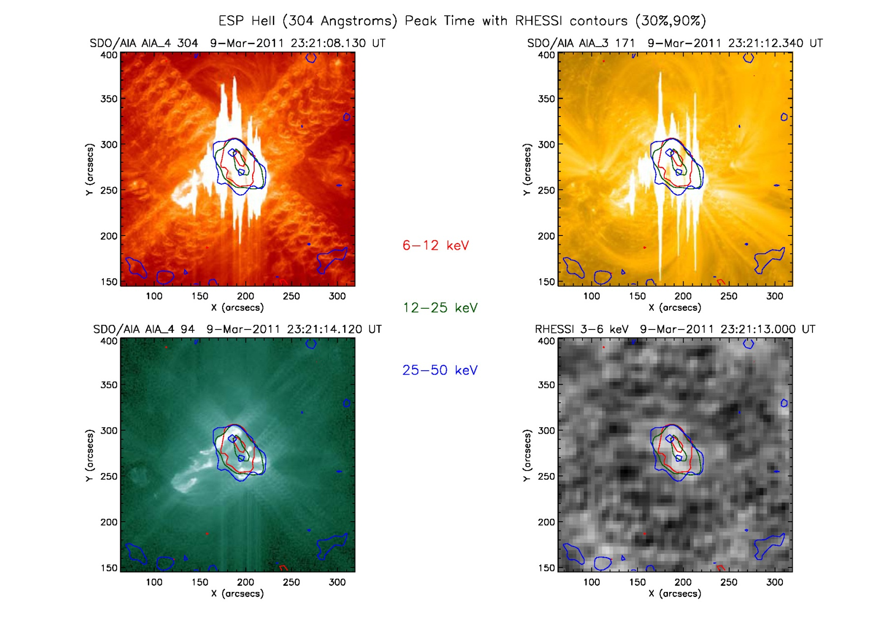

Slide 18
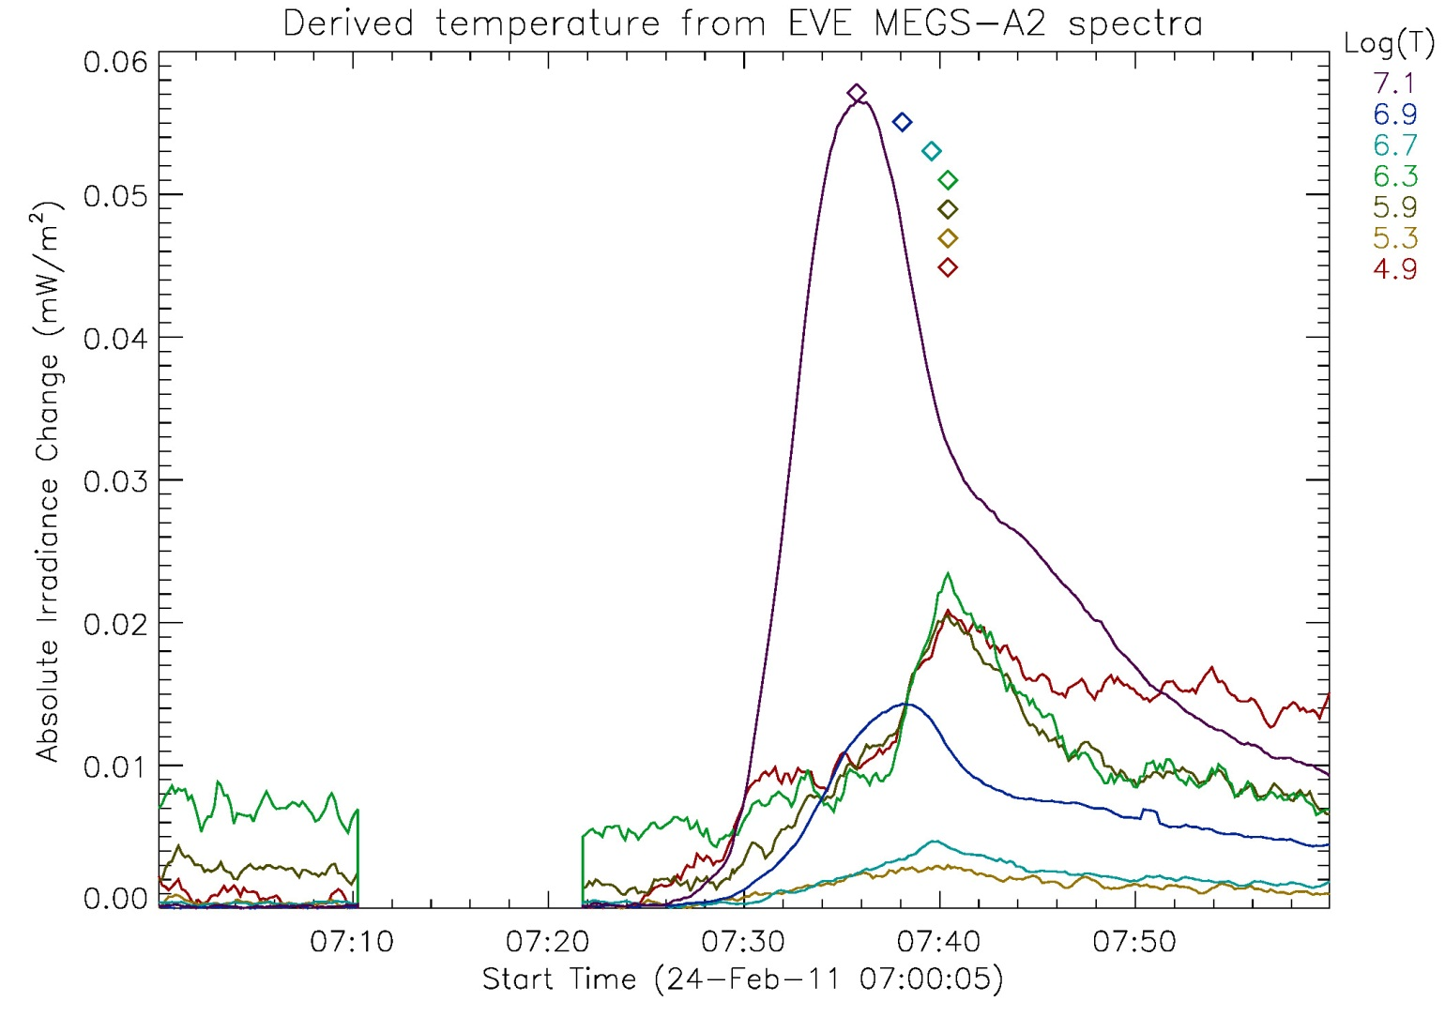

Slide 19
